Slide 1


Implementation Presentation
Bennet Hörmann, Salomo Hummel, Simeon Schrape, Erik Wu, Udo Zucker

Slide 2
What we implemented

Slide 3
What we implemented
1. User Management
2. Dashboard
3. Create experiment
4. Run experiment
5. Get experiment result

Slide 4
What we implemented
1. User Management
2. Dashboard
3. Create experiment
4. Run experiment
5. Get experiment result

Slide 5
What we implemented
1. User Management
2. Dashboard
3. Create experiment
4. Run experiment
5. Get experiment result

Slide 6
What we implemented
1. User Management
2. Dashboard
3. Create experiment
4. Run experiment
5. Get experiment result

Slide 7
What we implemented
1. User Management
2. Dashboard
3. Create experiment
4. Run experiment
5. Get experiment result

Slide 8
What we implemented
1. User Management
2. Dashboard
3. Create experiment
4. Run experiment
5. Get experiment result

Slide 9
What we implemented

Slide 10
Implemented
Not implemented
RO7: Filter/Search on dashboard
RO8: Sort on dashboard
RO13: Nested subspace logic
RO18: No ground-truth file needed
RO22: Run experiments concurrently
RO1: Delete account
RO2/3: Register/Login with email
RO4: Share experiment result
RO6: Forgot password feature
RO9: Loading animations
…
RO24: Show ROC curves for experiment
…
R027: Compare experiments
RO28: Light theme

Slide 11
Implemented
Not implemented
RO7: Filter/Search on dashboard
RO8: Sort on dashboard
RO13: Nested subspace logic
RO18: No ground-truth file needed
RO22: Run experiments concurrently
RO1: Delete account
RO2/3: Register/Login with email
RO4: Share experiment result
RO6: Forgot password feature
RO9: Loading animations
…
RO24: Show ROC curves for experiment
…
R027: Compare experiments
RO28: Light theme

Slide 12
Implemented
Not implemented
RO7: Filter/Search on dashboard
RO8: Sort on dashboard
RO13: Nested subspace logic
RO18: No ground-truth file needed
RO22: Run experiments concurrently
RO1: Delete account
RO2/3: Register/Login with email
RO4: Share experiment result
RO6: Forgot password feature
RO9: Loading animations
…
RO24: Show ROC curves for experiment
…
R027: Compare experiments
RO28: Light theme

Slide 13
Implemented
Not implemented
RO7: Filter/Search on dashboard
RO8: Sort on dashboard
RO13: Nested subspace logic
RO18: No ground-truth file needed
RO22: Run experiments concurrently
RO1: Delete account
RO2/3: Register/Login with email
RO4: Share experiment result
RO6: Forgot password feature
RO9: Loading animations
…
RO24: Show ROC curves for experiment
…
R027: Compare experiments
RO28: Light theme

Slide 14
Implemented
Not implemented
RO7: Filter/Search on dashboard
RO8: Sort on dashboard
RO13: Nested subspace logic
RO18: No ground-truth file needed
RO22: Run experiments concurrently
RO1: Delete account
RO2/3: Register/Login with email
RO4: Share experiment result
RO6: Forgot password feature
RO9: Loading animations
…
RO24: Show ROC curves for experiment
…
R027: Compare experiments
RO28: Light theme

Slide 15
Implemented
Not implemented
RO7: Filter/Search on dashboard
RO8: Sort on dashboard
RO13: Nested subspace logic
RO18: No ground-truth file needed
RO22: Run experiments concurrently
RO1: Delete account
RO2/3: Register/Login with email
RO4: Share experiment result
RO6: Forgot password feature
RO9: Loading animations
…
RO24: Show ROC curves for experiment
…
R027: Compare experiments
RO28: Light theme

Slide 16
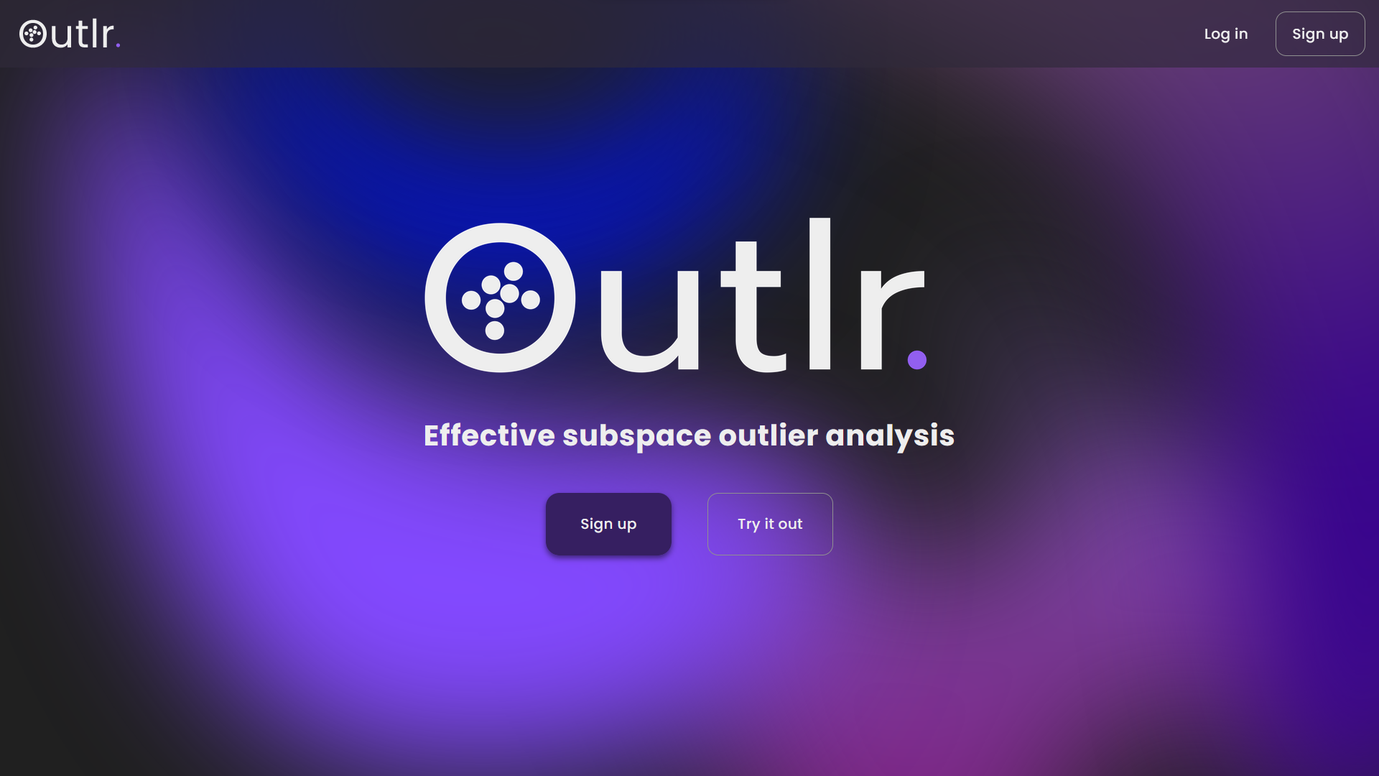
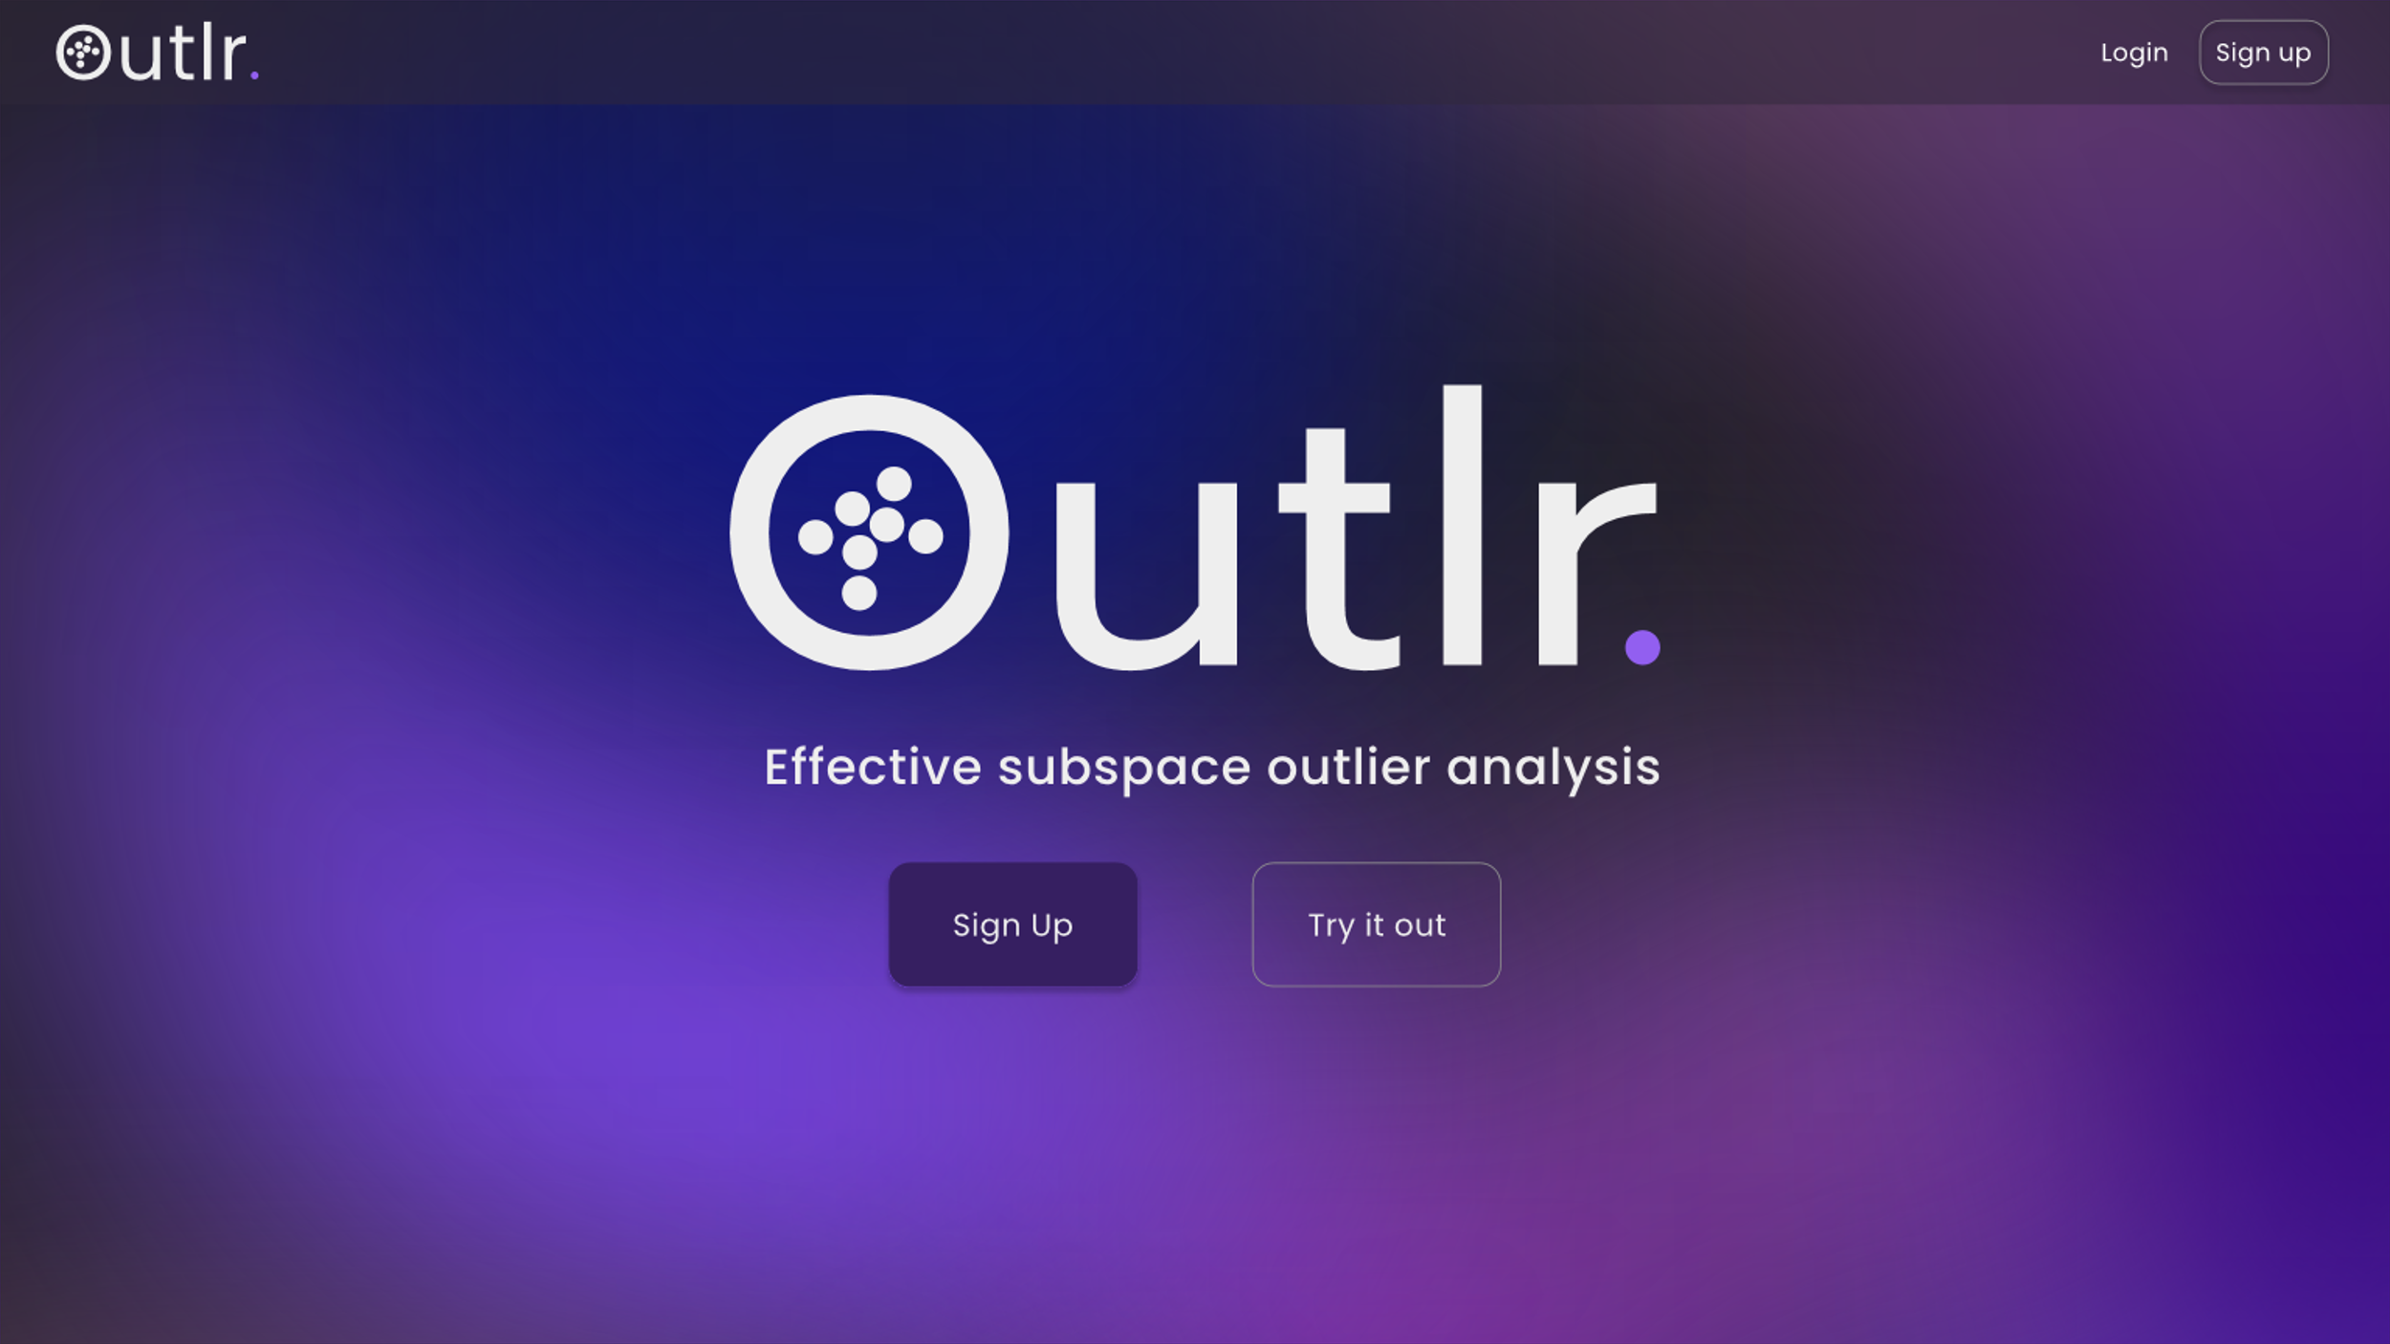

Slide 18
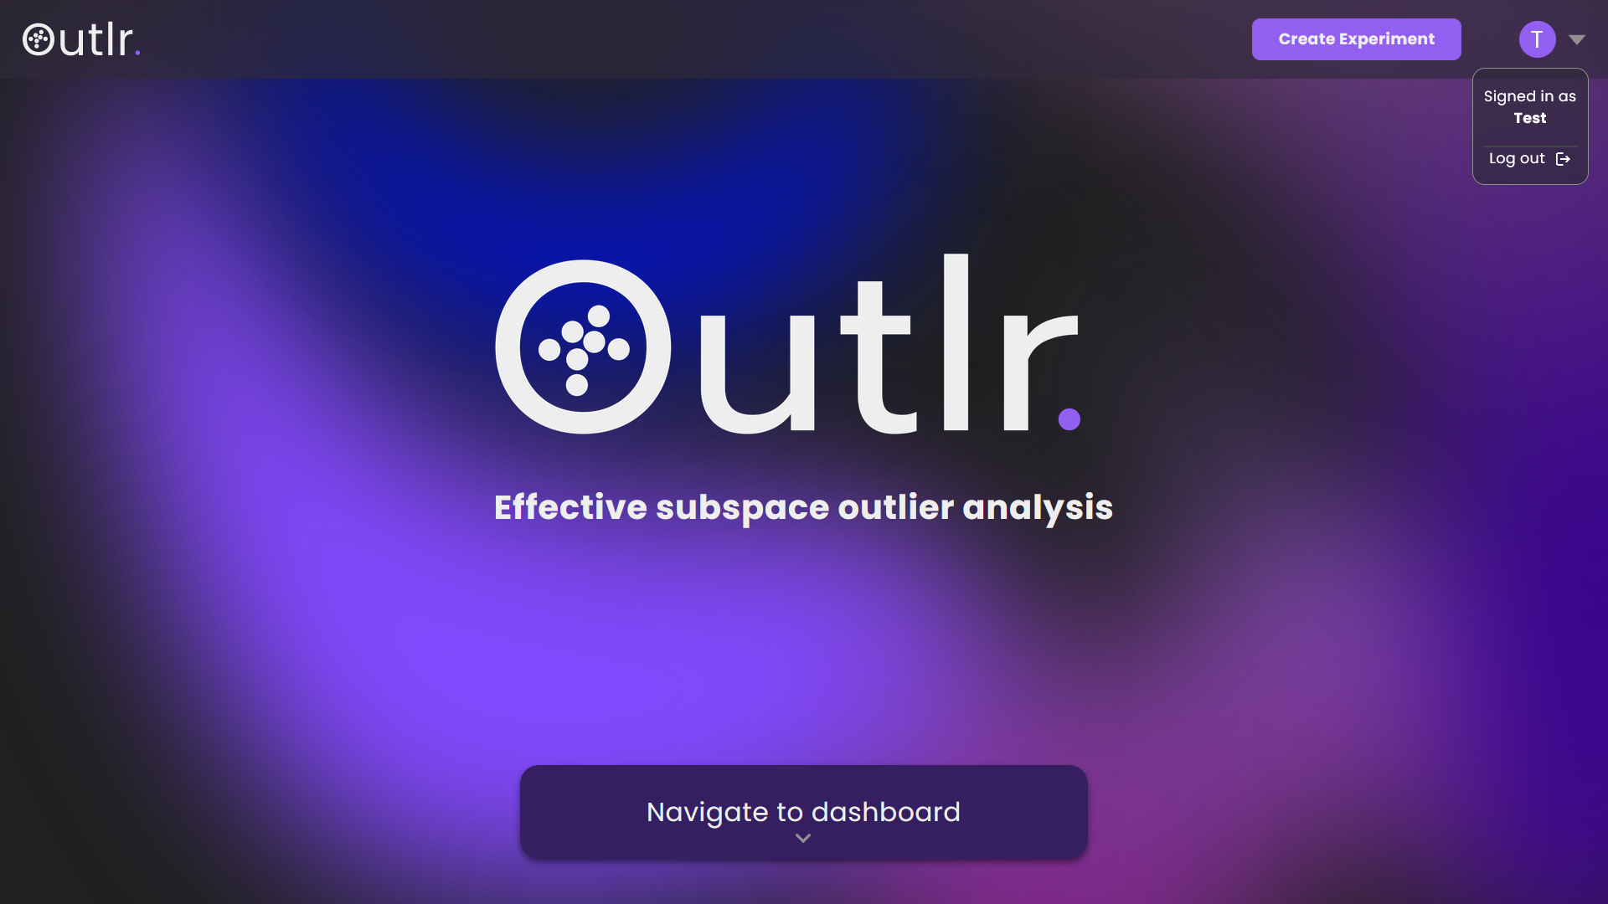
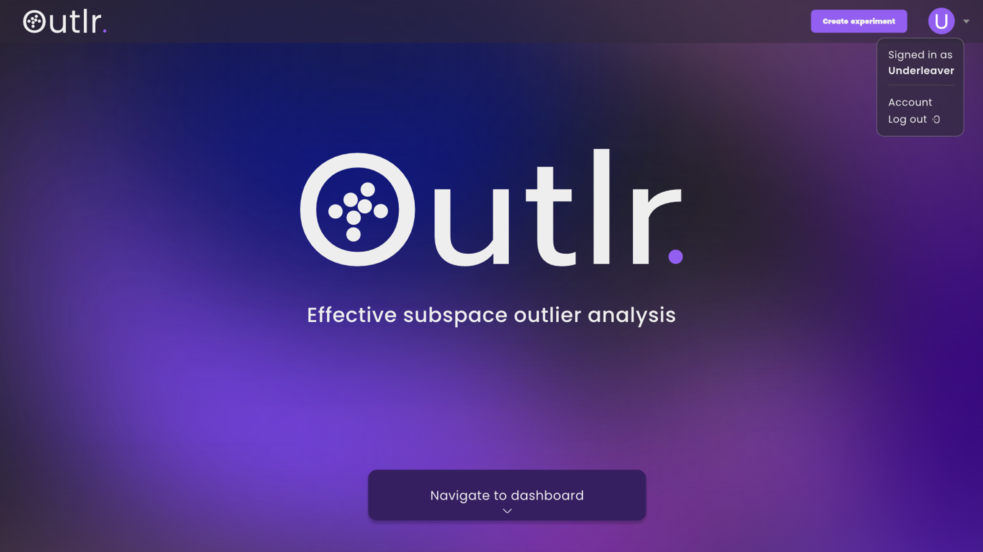

Slide 20
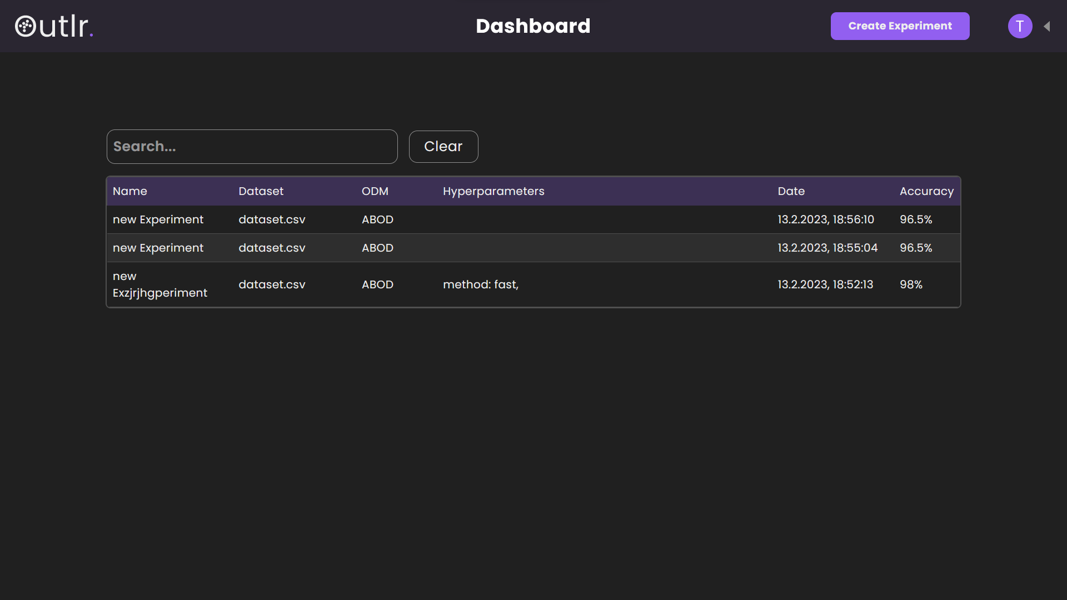
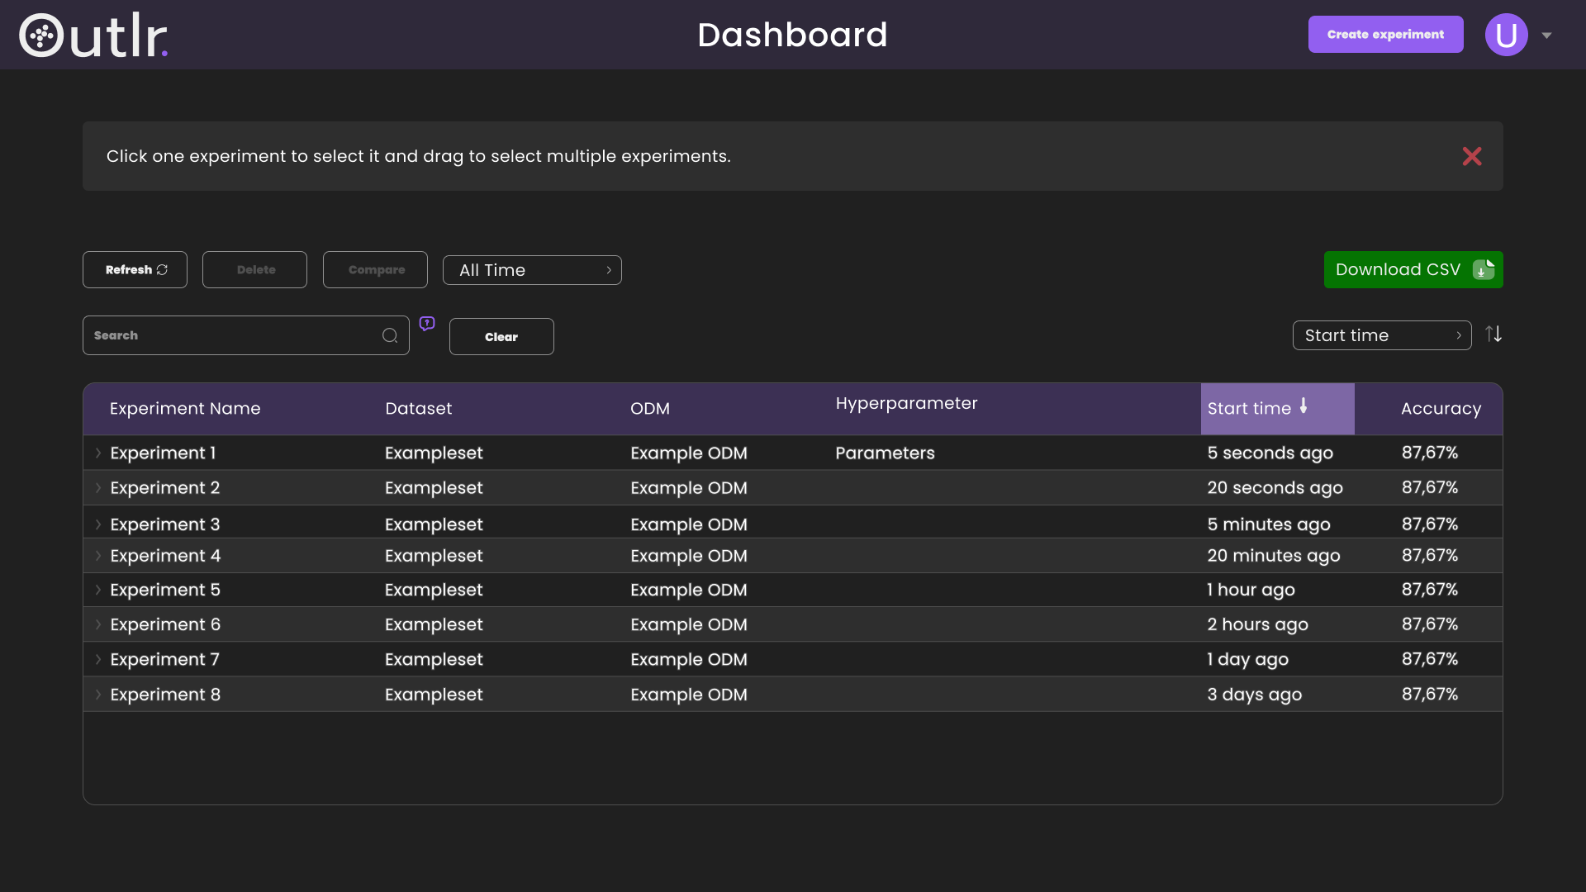

Slide 22
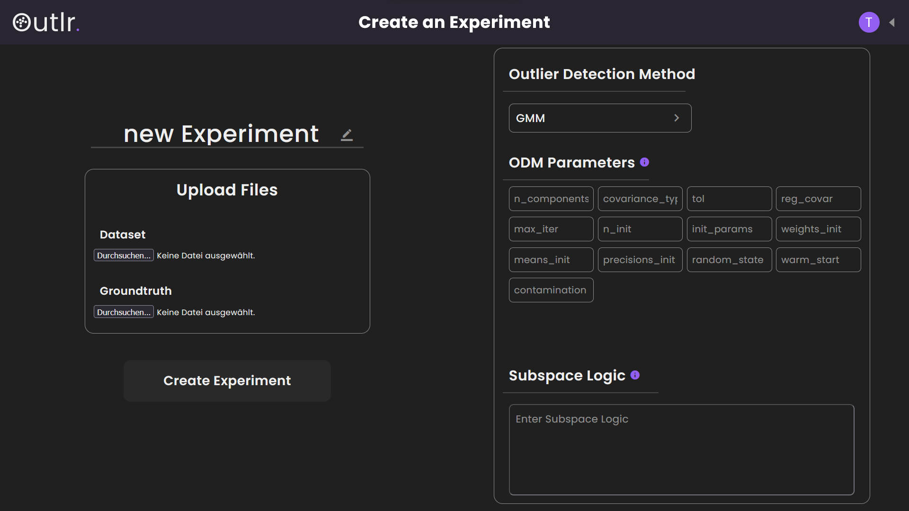
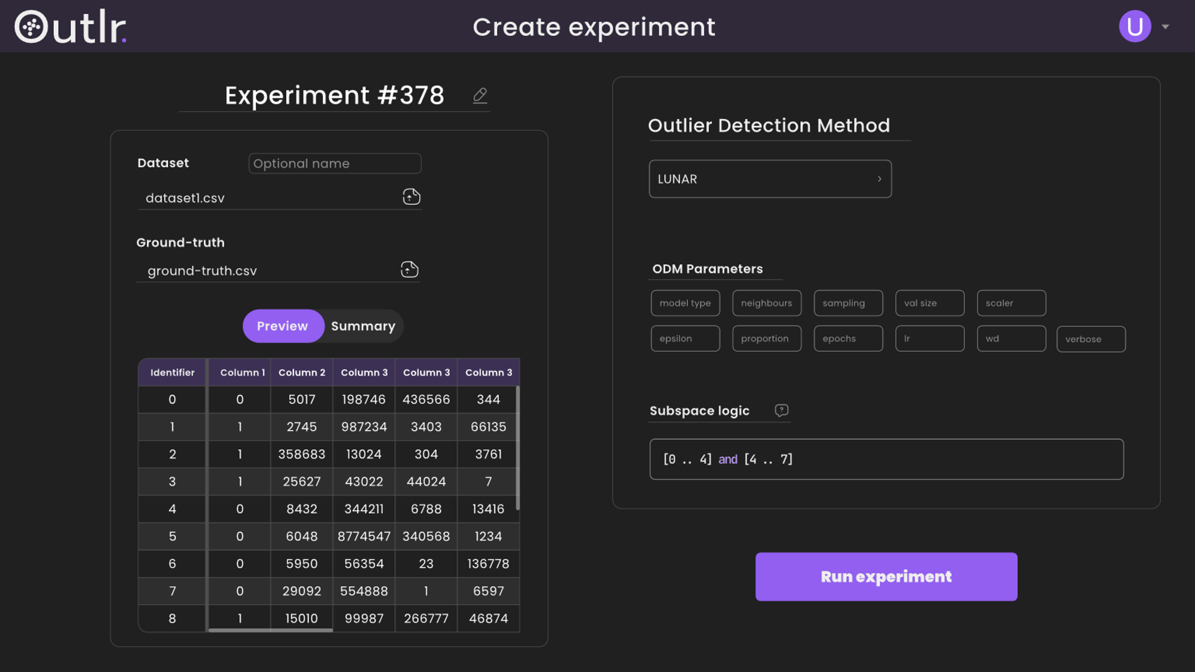

Slide 24
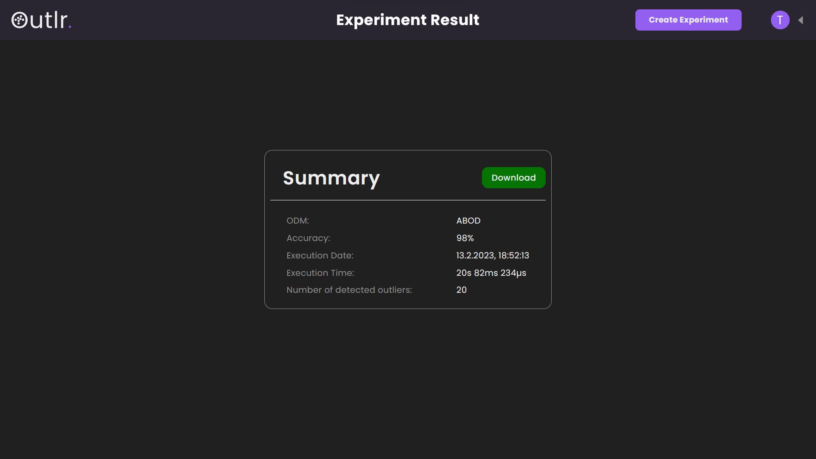
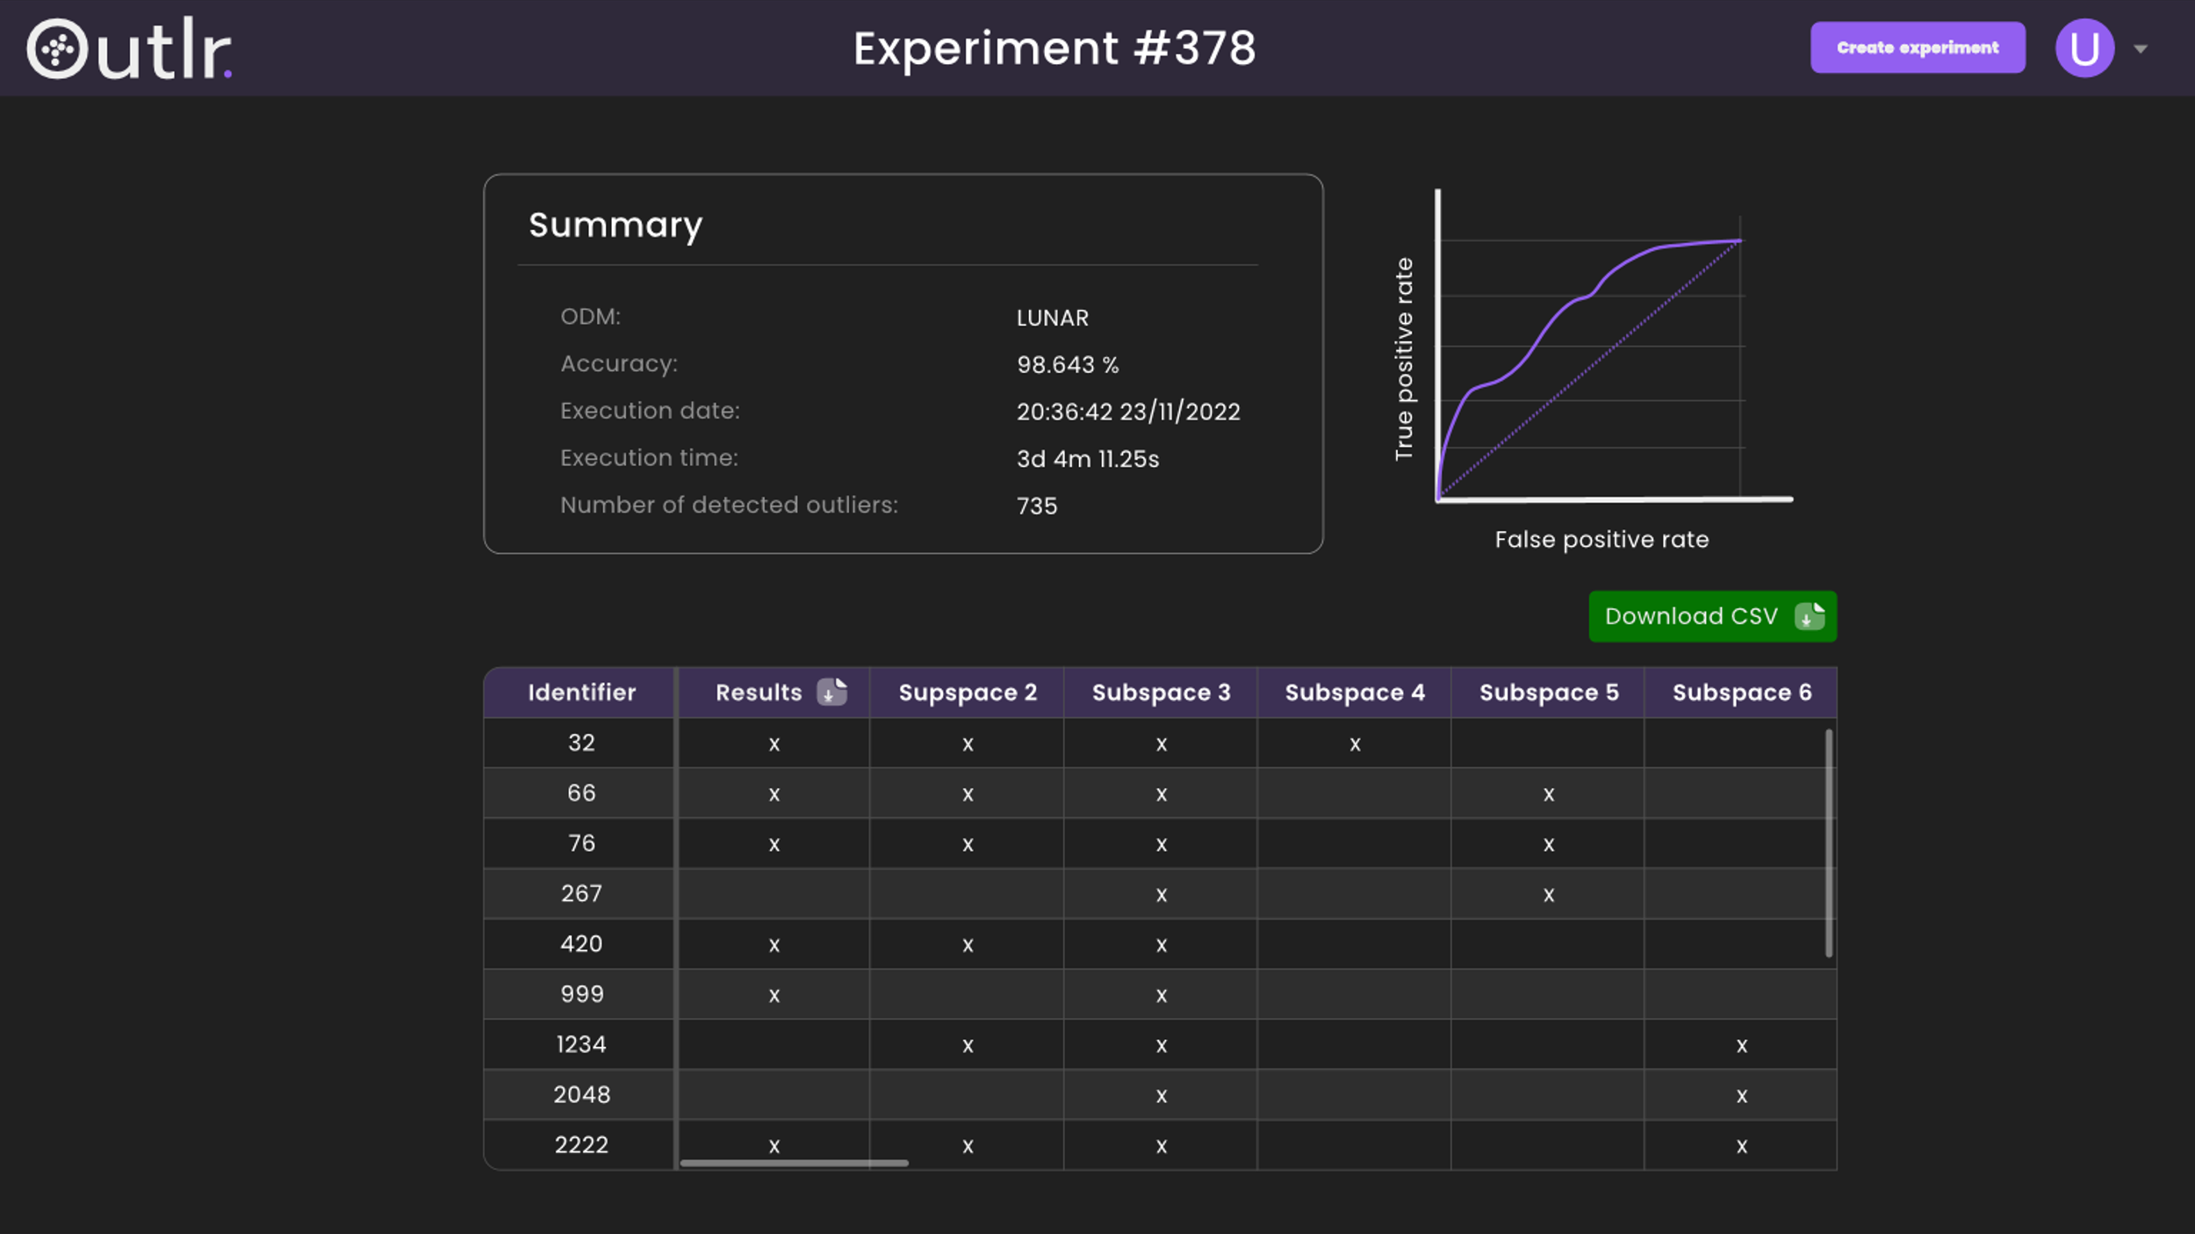

Slide 26
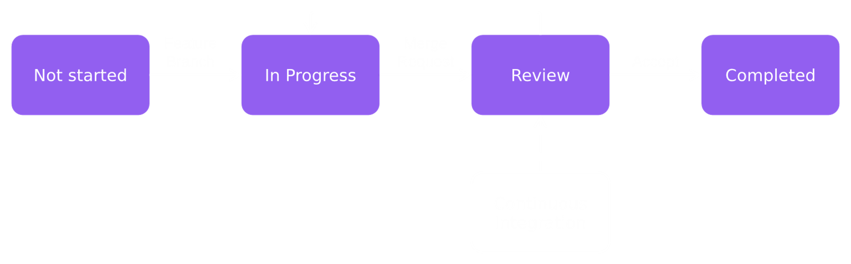
Workflow

Slide 27
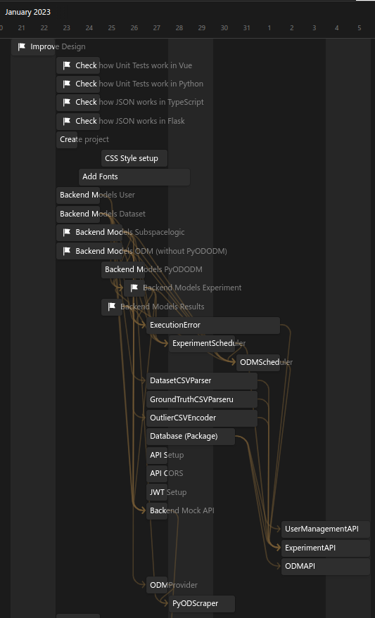
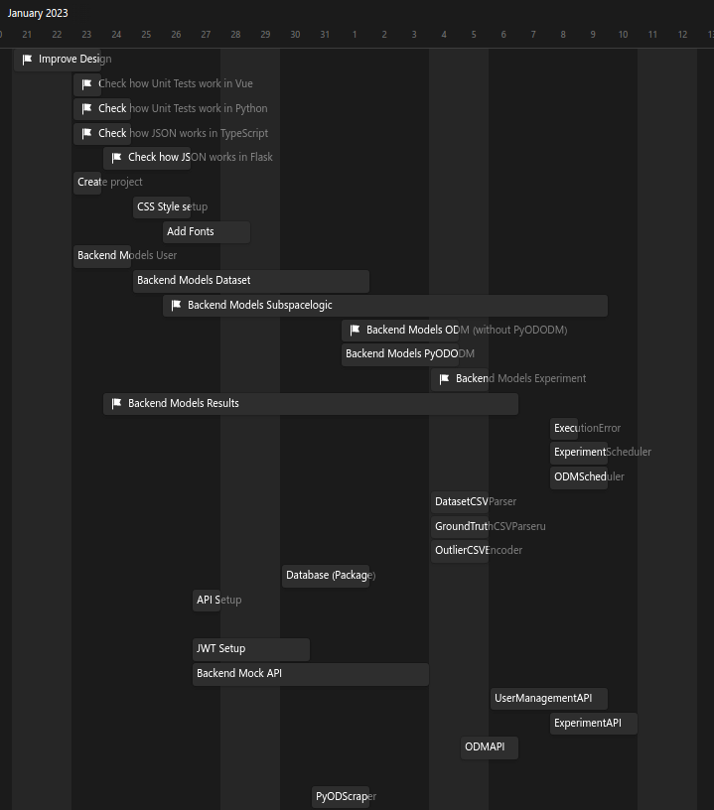

Slide 28
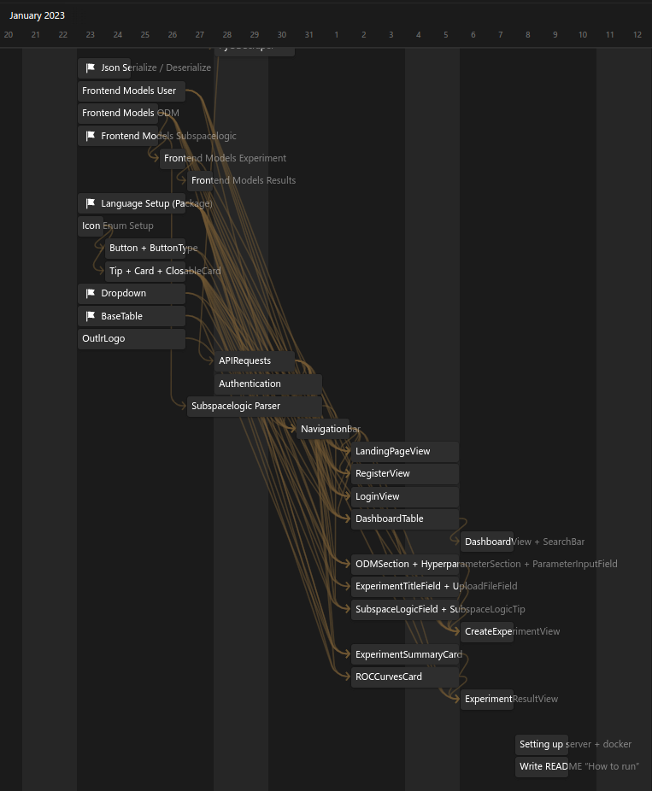
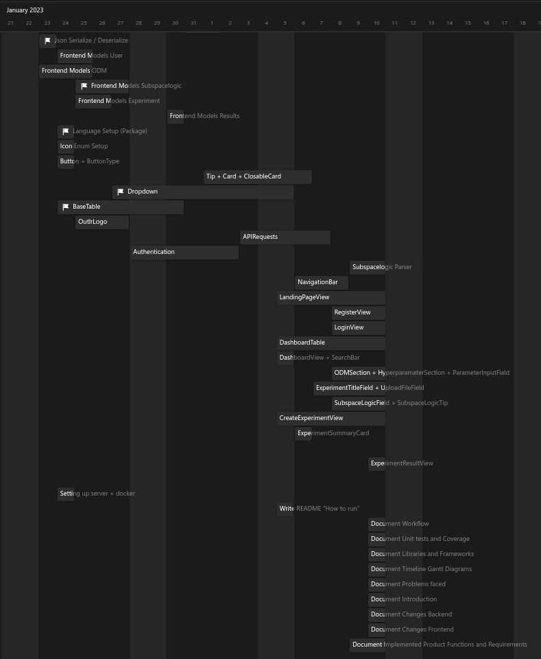

Slide 29
Problems Encountered

Slide 30
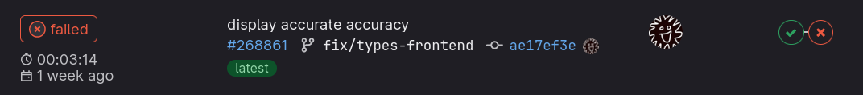
CI/CD Pipeline
Late CI setup
No Continuous Deployment

Slide 31
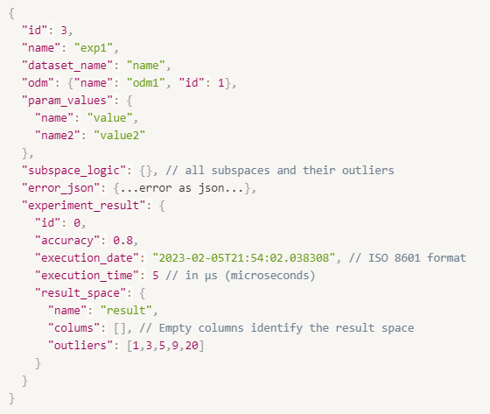
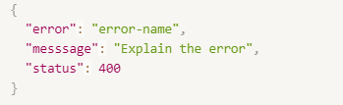
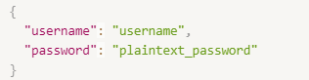
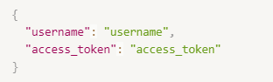
Defined JSON too late
Error JSON (response)
User JSON (request)
Experiment JSON (response)
User JSON (response)

Slide 32
Tasks took longer than expected
Cause:
Learn Language and Libraries
Unexpected complexity
Effect:
Frontend-Backend schedule didn't match
Unused Mock API

Slide 33
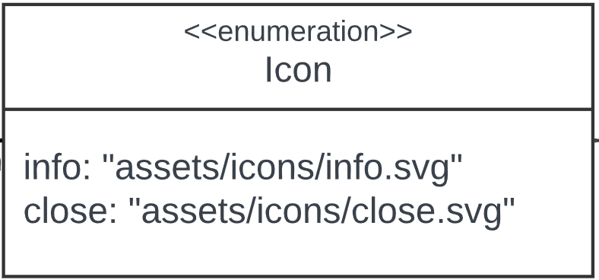
Changes made - Frontend

Slide 34
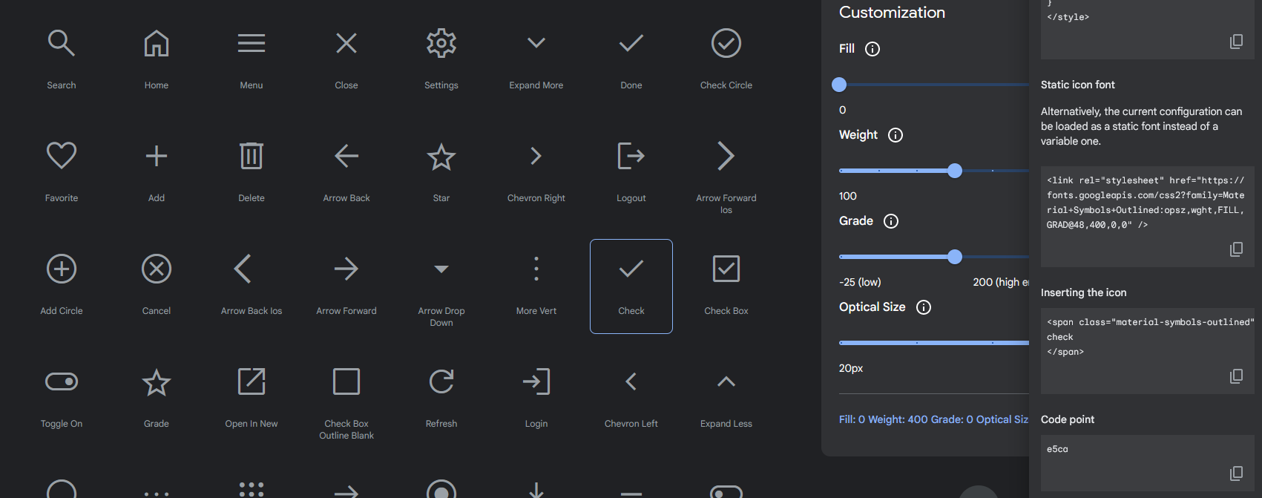
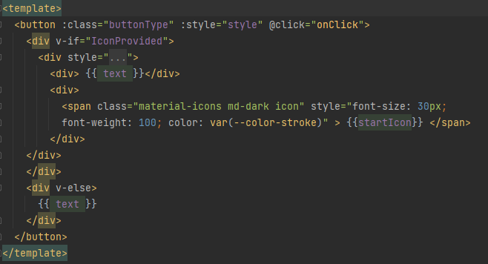
Changes made - Frontend

Slide 35
Changes made - Frontend

Slide 36
Changes made - Frontend

Slide 37
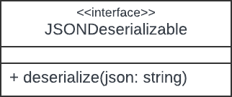
Changes - Frontend

Slide 38
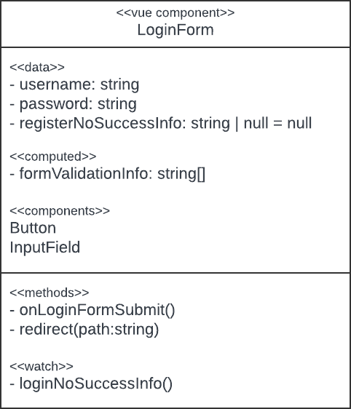
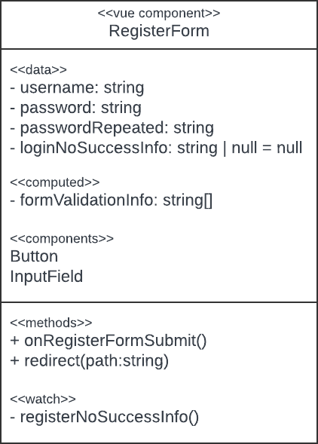
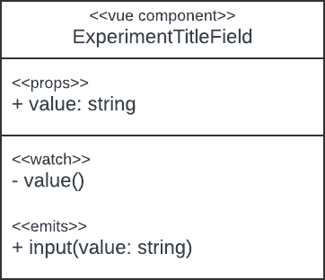
Changes - Frontend

Slide 39
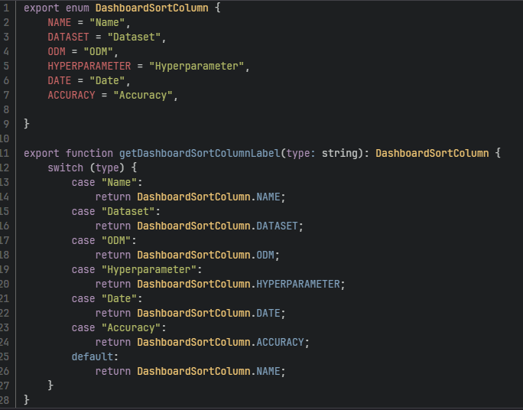
Changes - Frontend
Enum for dashboard sorting

Slide 40
Changes – Frontend – API
Renamed and added some methods

Slide 41
Changes in general - Backend
np.NDArray were used in place of python lists
static classes, variables not implemented as classes

Slide 42
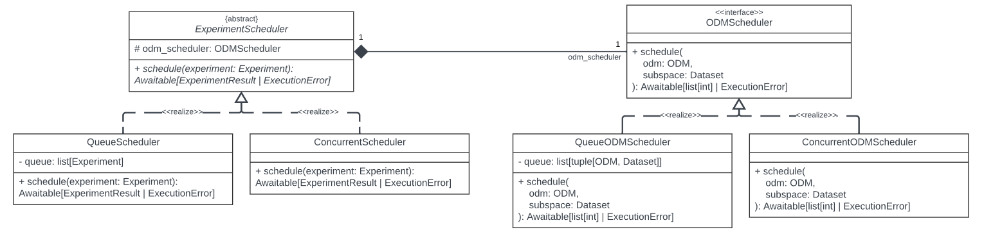
Changes - Backend

Slide 43
Changes - Backend

Slide 44
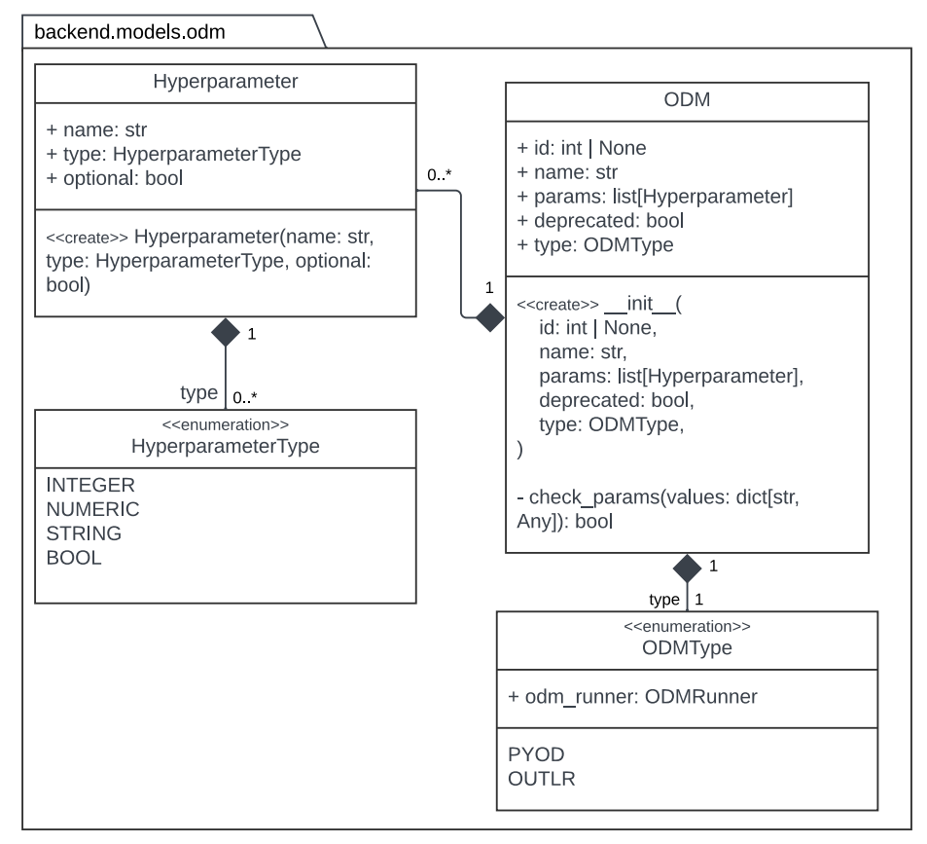
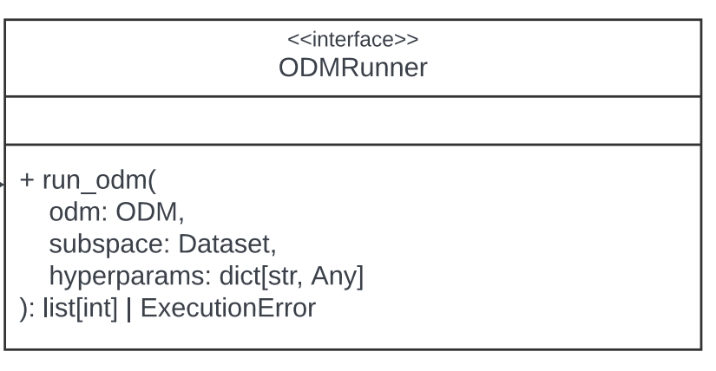
Changes - Backend

Slide 45
Changes - Backend

Slide 46
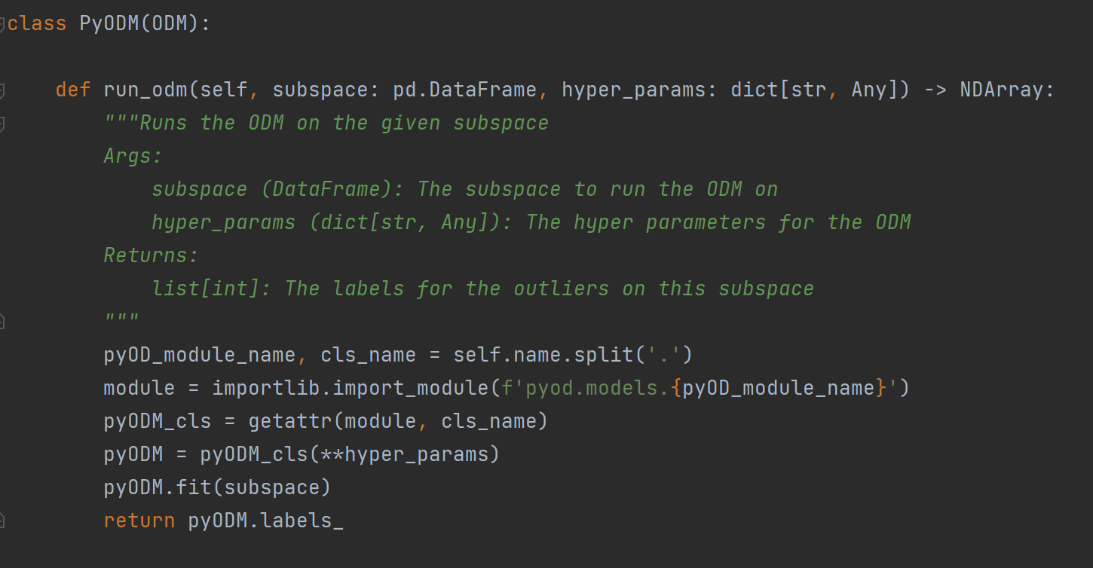
Changes - Backend

Slide 47
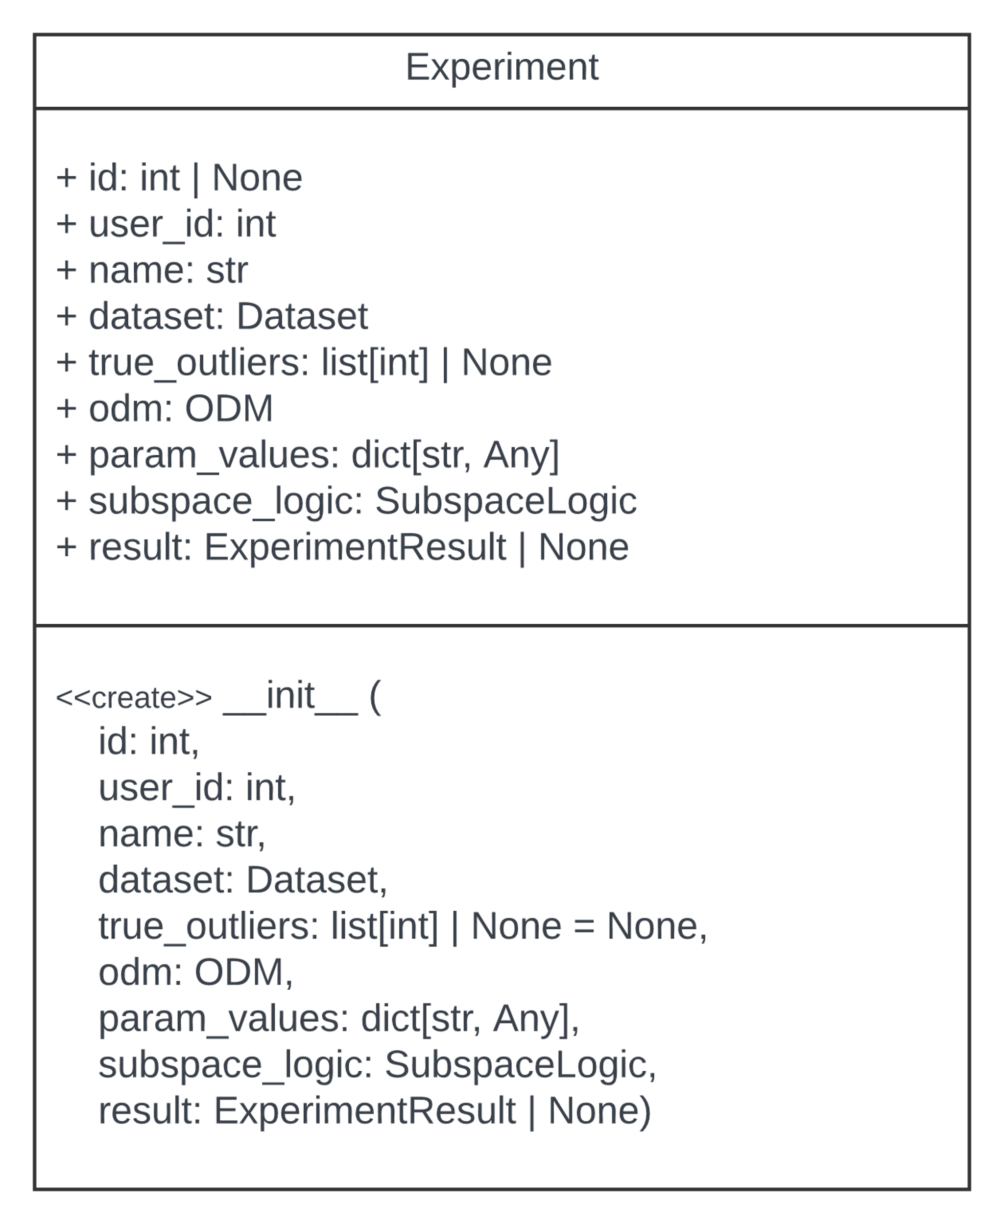
Changes - Backend

Slide 48
Changes - Backend

Slide 49
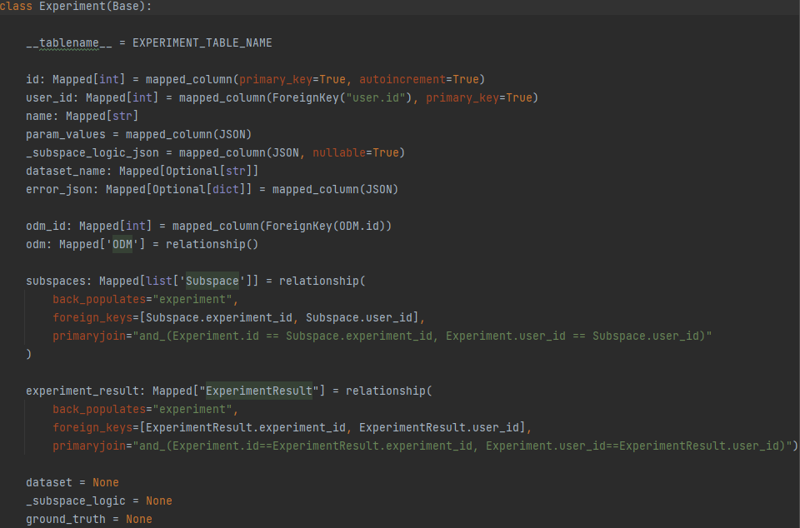
Changes - Backend

Slide 50
Changes - Backend

Slide 51
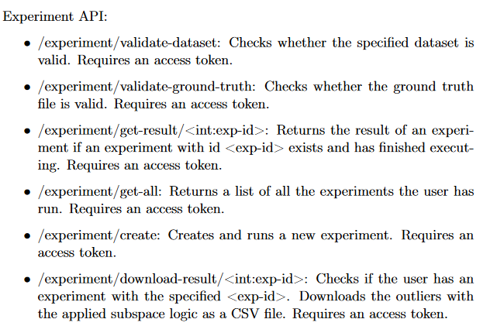
Changes – Backend

Slide 52
Changes – Backend
Experiment creation
Dataset and potentially ground truth (Form data)
Experiment information passed by user (JSON)

Slide 53
Changes – Backend
Experiment creation
Dataset and potentially ground truth (Form data)
Experiment information passed by user (JSON)

Slide 54
Changes – Backend
Experiment creation
Dataset and potentially ground truth (Form data)
Experiment information passed by user (JSON)

Slide 55
Changes – Backend
Experiment creation
Dataset and potentially ground truth (Form data)
Experiment information passed by user (JSON)

Slide 56
Changes – Backend
Experiment creation
Dataset and potentially ground truth (Form data)
Experiment information passed by user (JSON)
Added /experiment/upload-files to API
to upload the .csv files for an experiment

Slide 57
Code-Statistics
Ca. 6400 Lines of Code

Slide 58
DEMO

Slide 59
Now to the Demon-stration

Slide 60
Now to the Demon-stration

Slide 61
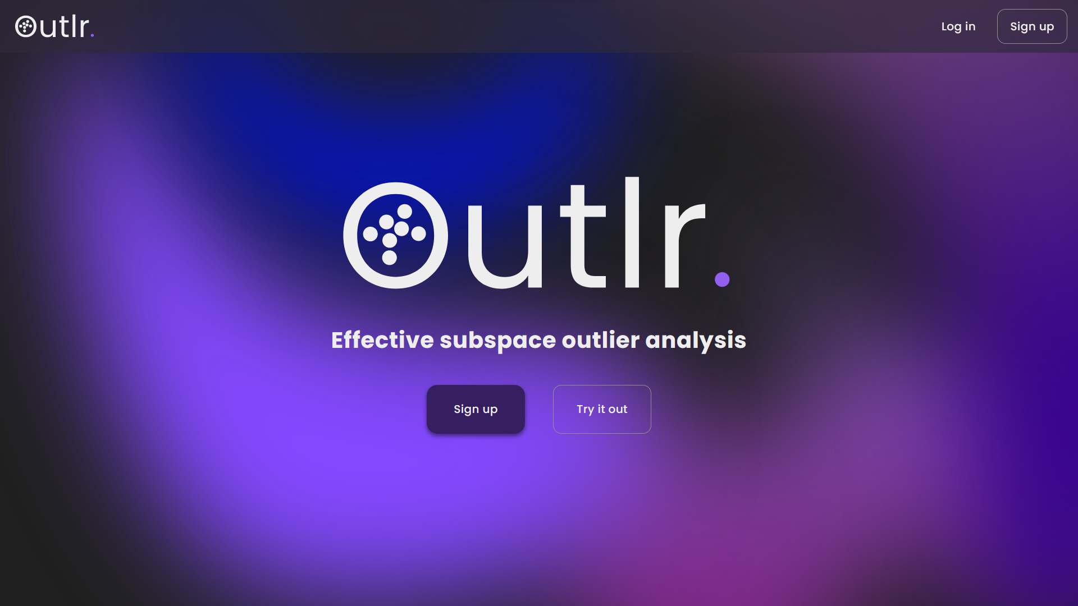

Slide 62
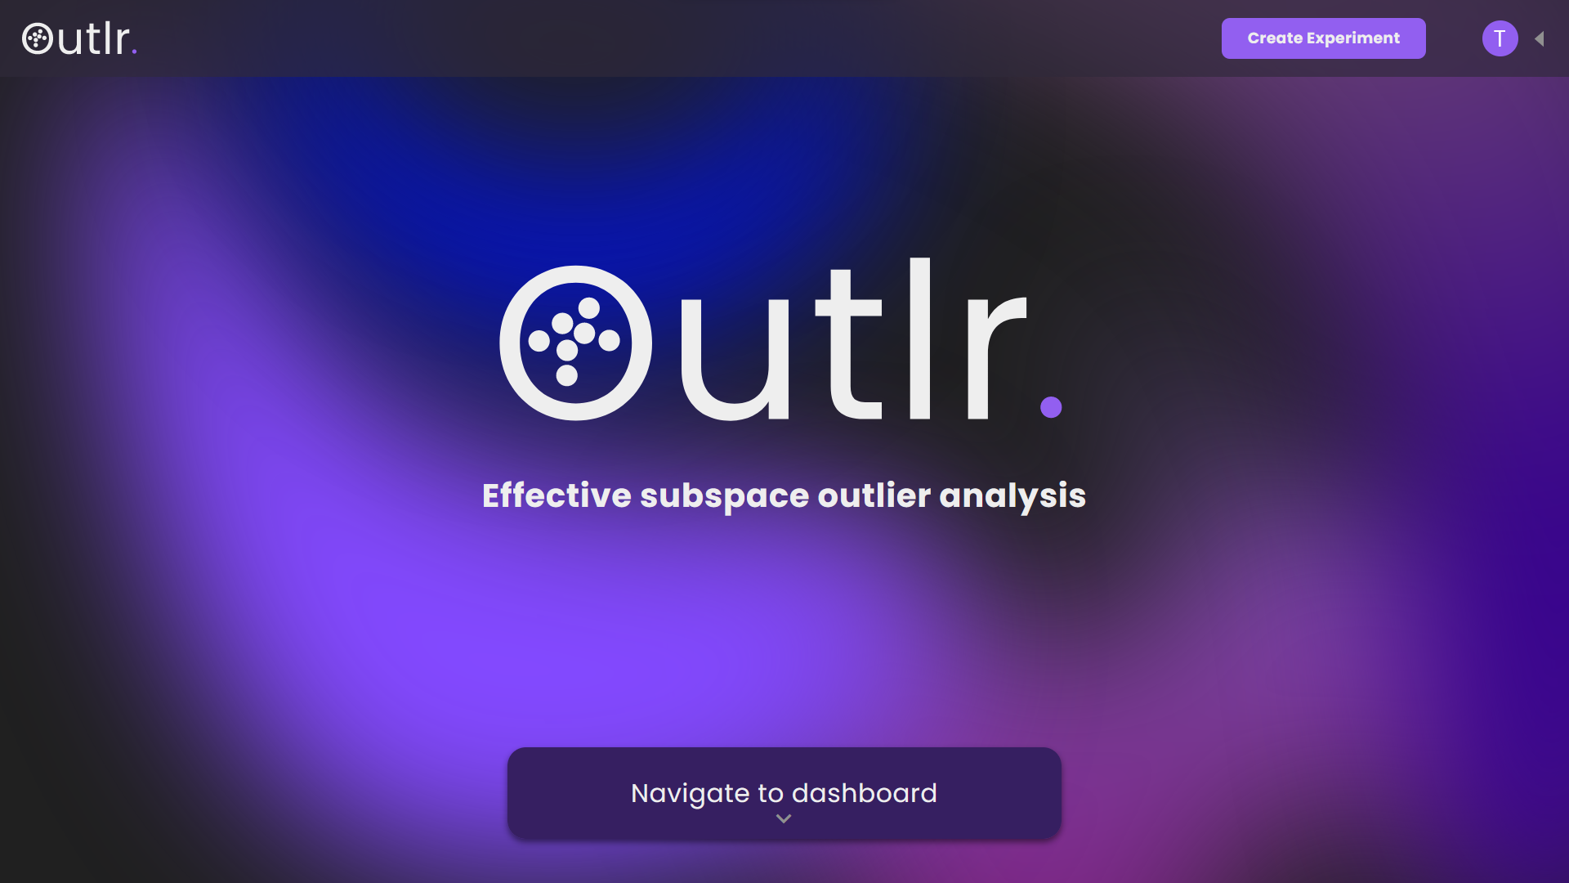

Slide 63
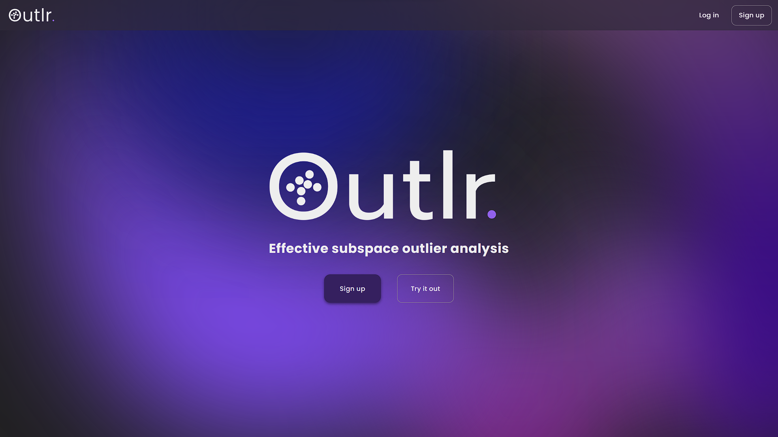

Slide 64
